Slide 1
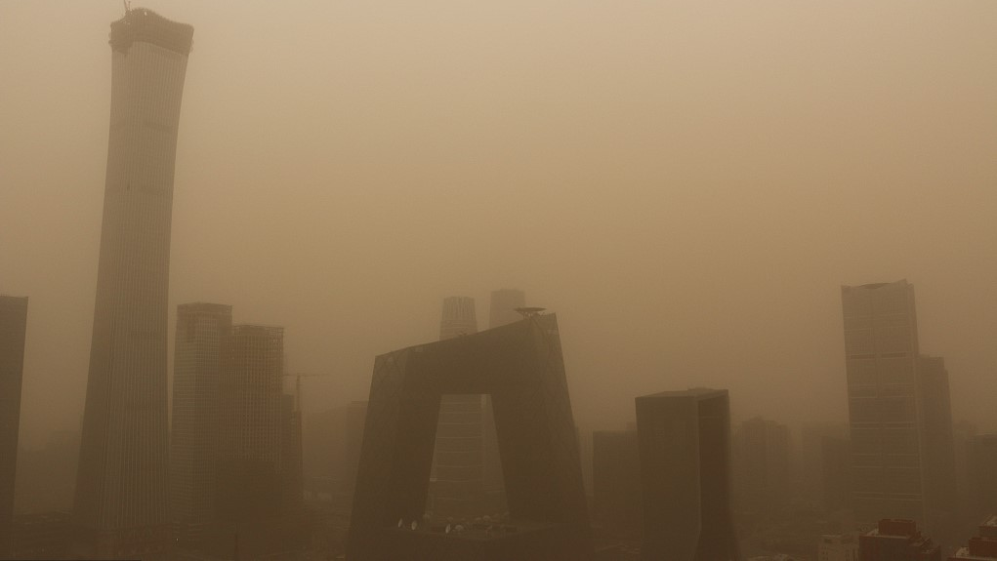
PM 2.5: Air Quality in Urban Areas
Benjamin Lee

Slide 2
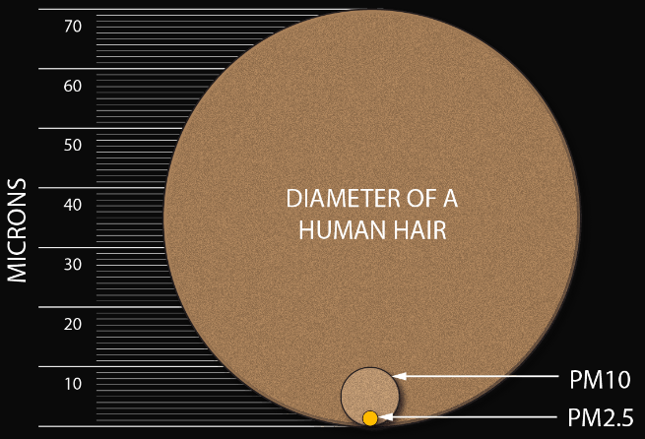
What is PM 2.5?
Fine particulate matter
2.5 microns or less in width
Able to travel past respiratory defenses and cause sickness
For reference, N95 masks can filter out 95% of airborne particles > 0.3 microns
Source: undark.org

Slide 3
About the Dataset
Hourly PM 2.5 data from US Embassy in Beijing (2010 – 2014)
43,824 samples
Sourced from UCI website
Variables:
Date (year, month, day, hour)
PM 2.5 concentration (μg / m³)
Dew point (°C)
Temperature (°C)
Pressure (hPa)
Combined wind direction
Cumulative wind speed (m/s)
Cumulative hours of snow
Cumulative hours of rain

Slide 4
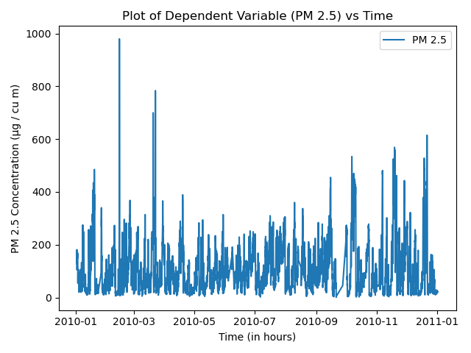
Dependent Variable vs Time
Rough pattern of peaks at the beginning of each year and dips in the middle
Difficult to discern a noticeable pattern

Slide 5
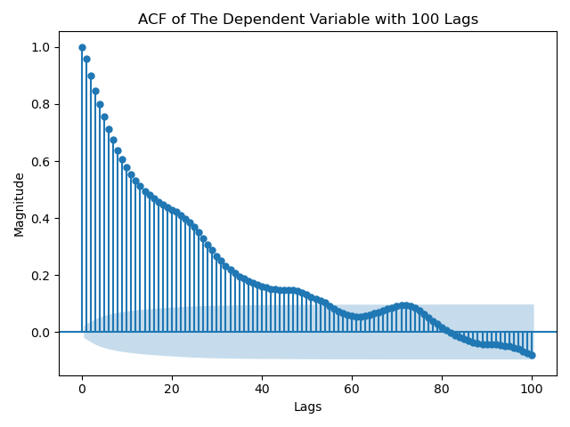
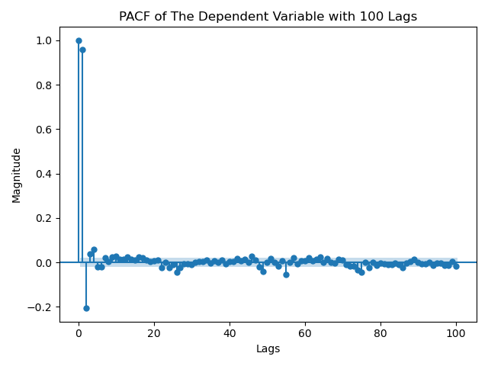
ACF & PACF
Seasonal spikes every 24 lags
Likely AR/MA seasonal (SARIMA)
Will try first-order seasonal differencing, followed by first-order non-seasonal differencing

Slide 6
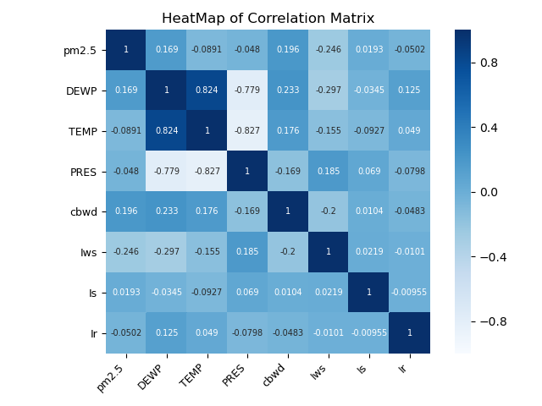
Correlation Matrix
Strong correlations
Dew point & Temperature (+)
Dew point & Pressure (-)
Dependent variable possesses weak correlation with every independent variable
Relationships may not be linear

Slide 7
Stationarity
Augmented Dickey-Fuller Test
ADF Statistic: -21.338838
p-value: 0.000000
Critical Values:
1%: -3.430
5%: -2.862
10%: -2.567
Although the ADF test proves stationarity, the ACF/PACF do not

Slide 8
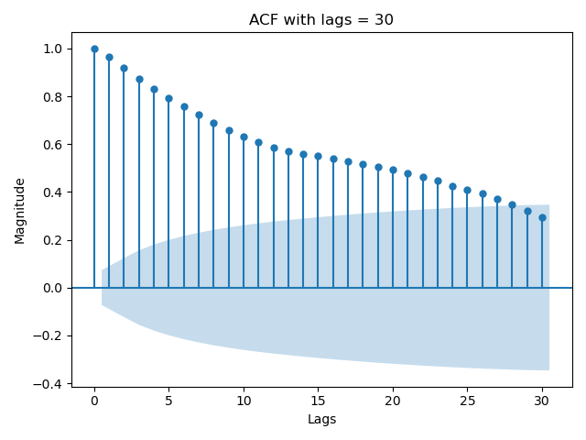
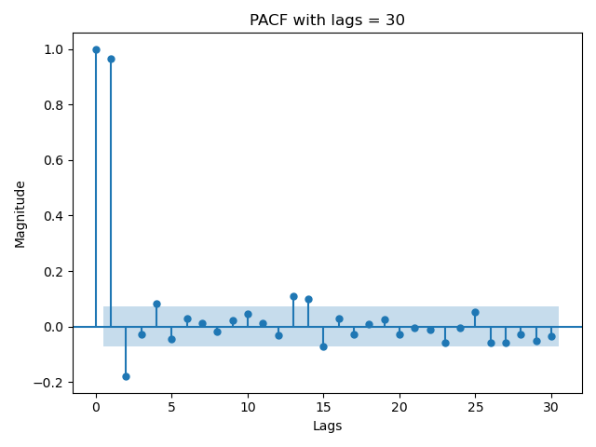
ACF & PACF
Noticeable cut-off in ACF in F.O.S, tailing-off in PACF
Tailing-off in ACF and PACF in F.O.N.S
ADF test stationary
ADF stat: -25.2815, p-val = 0.00
Will try:
SARIMA (2, 0, 0) x (1, 0, 0, 24)
SARIMA (2, 0, 0) x (2, 0, 0, 24)
SARIMA (1, 1, 0) x (0, 1, 1, 24)

Slide 9
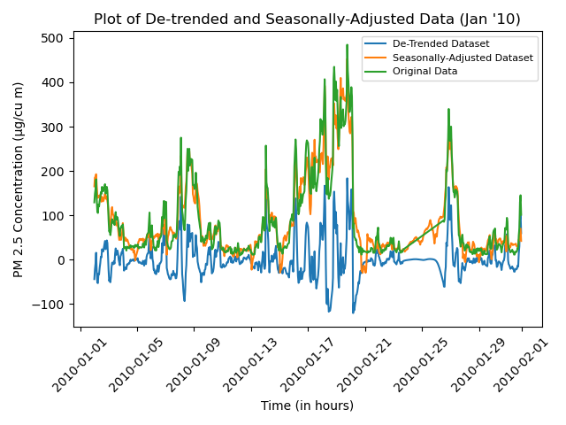
Time Series Decomposition
F_{T} = 0.8669
F_{S} = 0.41101
Data is highly trended
De-trended data
ADF Statistic: -8.973585
p-value: 0.000000
Critical Values:
1%: -3.440
5%: -2.866
10%: -2.569
Seasonally-adjusted data
ADF Statistic: -3.903025
p-value: 0.002013
Critical Values:
1%: -3.440
5%: -2.866
10%: -2.569

Slide 10
Feature Selection
Combined wind direction removed due to categorical nature
All predictors retained p-values below threshold of 0.05
F-statistic: 0.00; reject null hypothesis
R-squared: 0.239
Adjusted R-squared: 0.238
AIC: 79,840
BIC: 79,890
Looking ahead: try to increase R-squared/Adjusted R-squared values (very small)

Slide 11
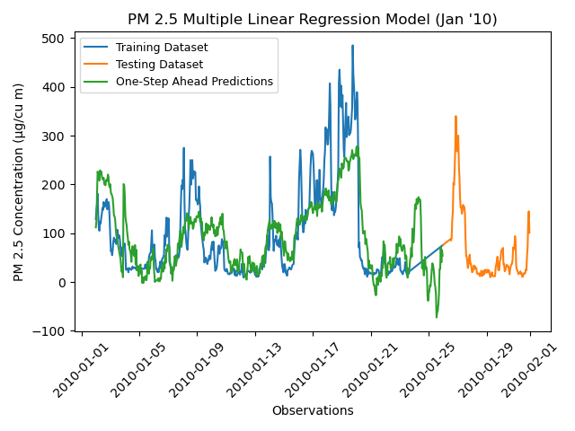
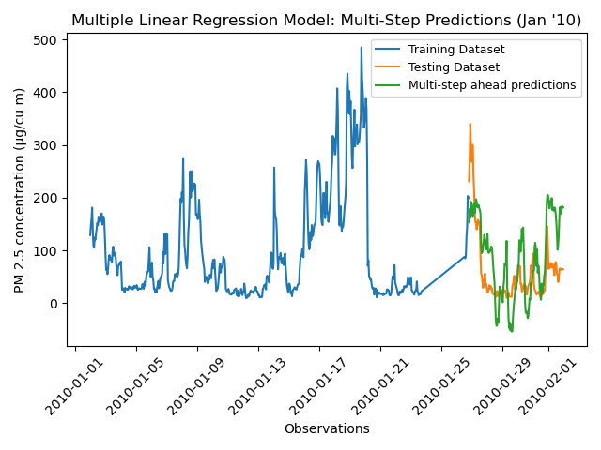
Multiple Linear Regression
One-step ahead predictions capture bulk of training set within PM 2.5 values of 0 – 200
Multi-step ahead: very poor performance
Closer look at first 30 days reveals better comparison

Slide 12
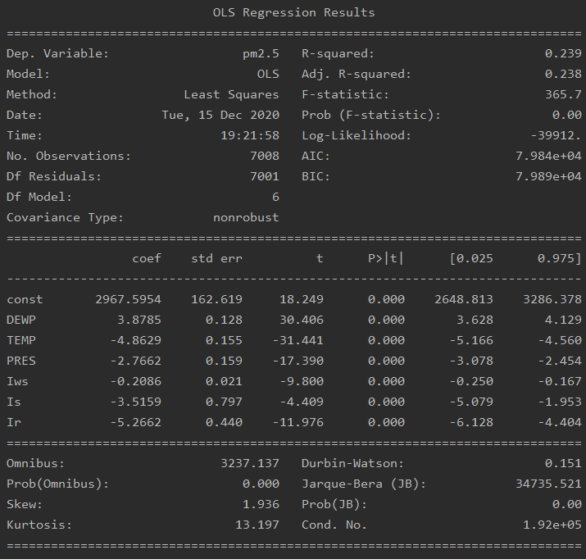
Multiple Linear Regression
T-tests all reject null and conclude that the coefficients obtained are nonzero
F-test rejects null and concludes model provides better fit than intercept-only
AIC/BIC large, but R-squared and Adj. R-squared very low

Slide 13
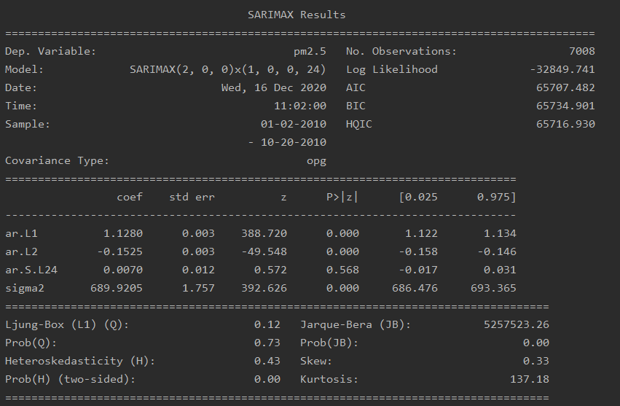
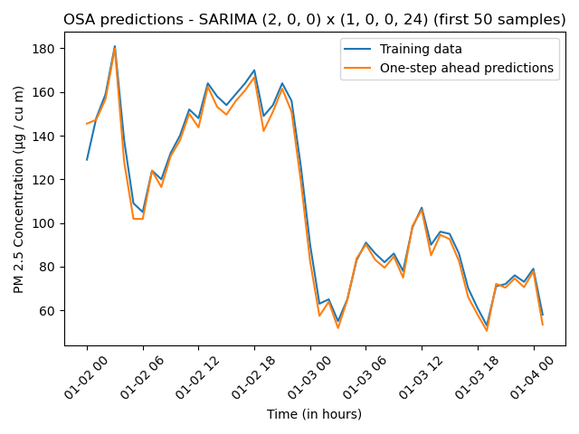
SARIMA Modelling
SARIMA (2, 0, 0) x (1, 0, 0, 24)
Worrisome p-value for A1
Otherwise, looks great

Slide 14
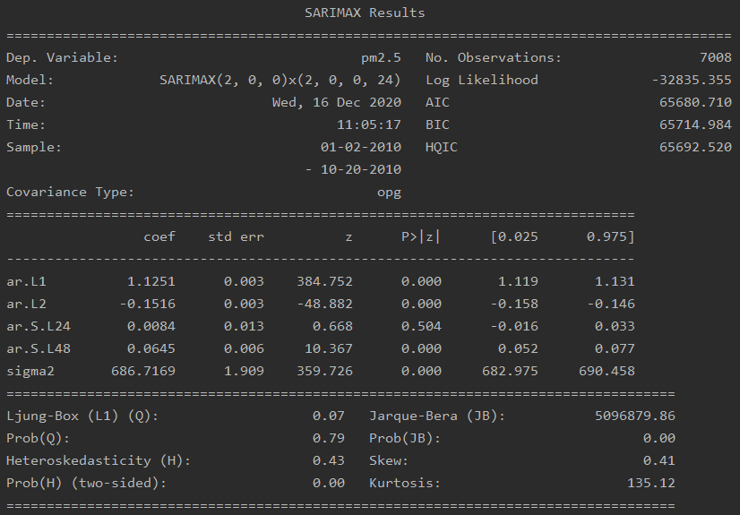
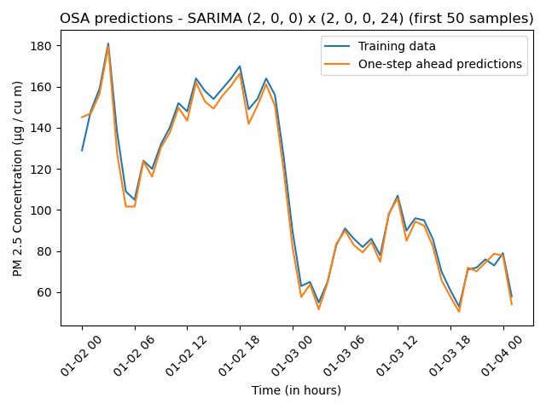
SARIMA Modelling
SARIMA (2, 0, 0) x (2, 0, 0, 24)
Worrisome p-value at A1 again
OSA predictions look great

Slide 15
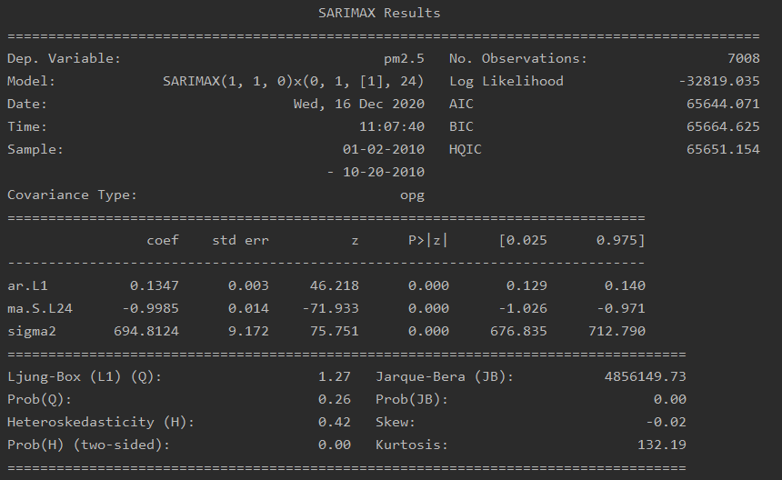
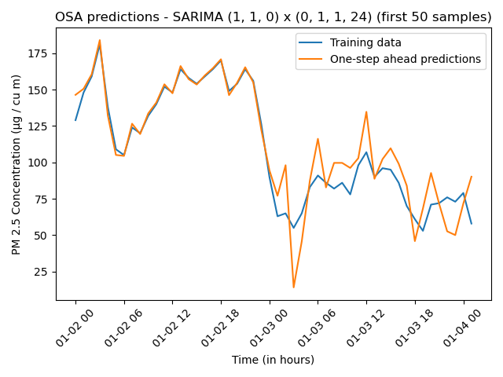
SARIMA Modelling
SARIMA (1, 1, 0) x (0, 1, 1, 24)
P-values look good
OSA is much worse than other two SARIMA models

Slide 16
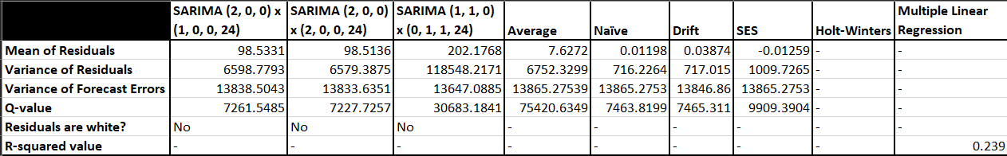
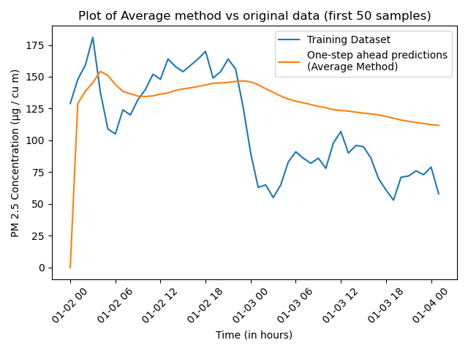
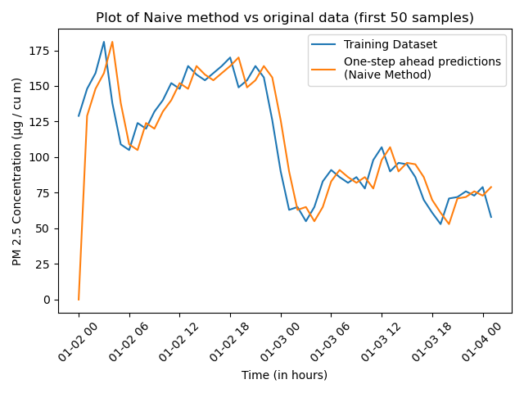
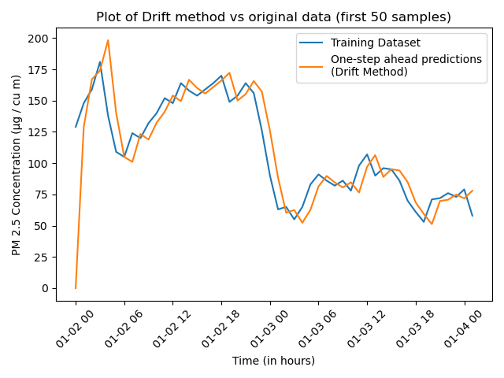
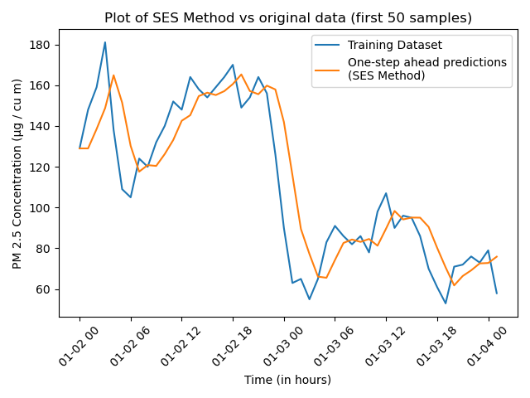
Model Selection
Base Models
Overall, pretty good OSA predictions
Near-zero mean of residuals (unbiased estimator)
Generally lower variances and Q-values than SARIMA models

Slide 17
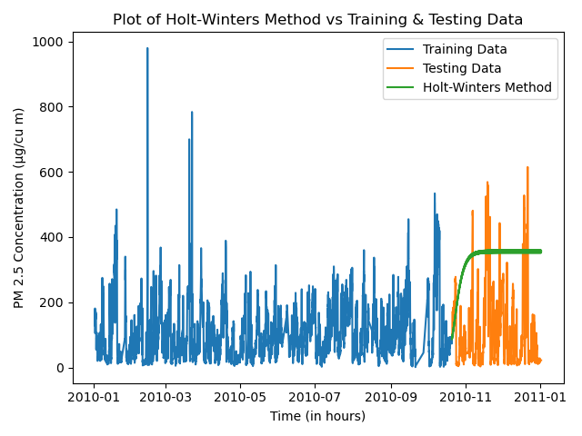
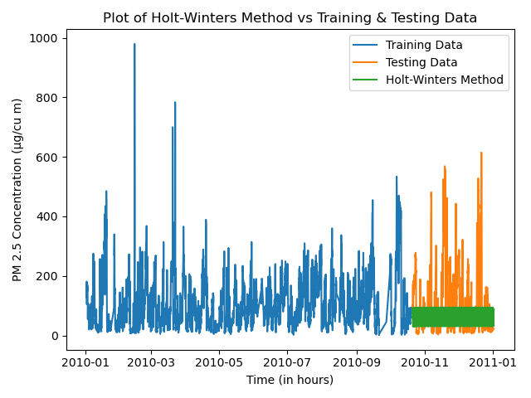
Model Selection
Holt-Winters, Holt’s Linear Trend and Multiple Linear Regression
Generally, very bad prediction/forecast matchups with original data
R-squared value of MLR is terrible
AIC and BIC of MLR are high, pointing to a high SSE

Slide 18
Model Selection
SARIMA models
OSA predictions are great for SARIMA (2, 0, 0) x (1, 0, 0, 24) and SARIMA (2, 0, 0) x (2, 0, 0, 24), but bad for SARIMA (1, 1, 0) x (0, 1, 1, 24)
Mean of residuals are high

Slide 19
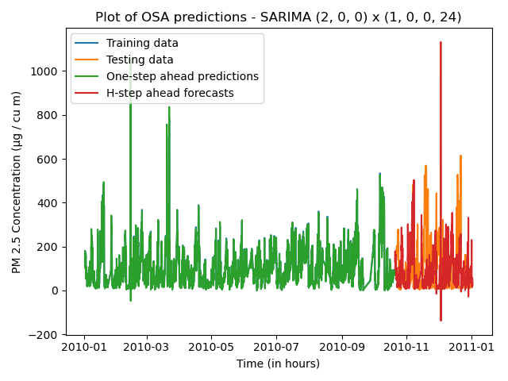
Selected Model
SARIMA (2, 0, 0) x (1, 0, 0, 24)
Q-values uncertain
Despite mean of residuals and variances, OSA predictions are nearly perfect

Slide 20
Selected Model
SARIMA (2, 0, 0) x (1, 0, 0, 24)
HAS forecasts perform well against the test set
Seasonal components present in ACF and PACF plots not captured by base models

Slide 21
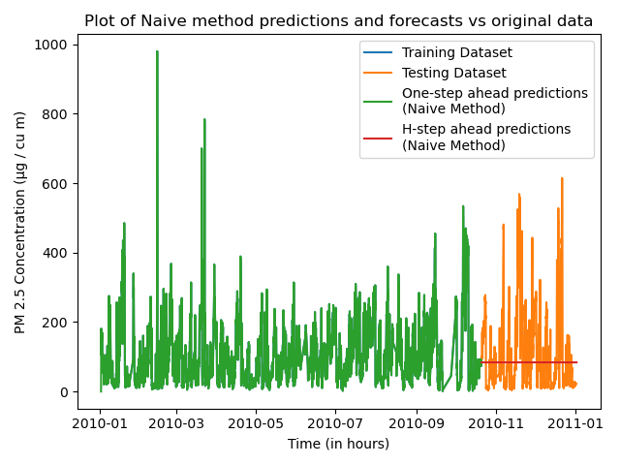
Future Ideas
Implement seasonal Naïve
Naïve method performed moderately well; perhaps adding seasonal component will improve results.

Slide 22

Thank you!

